Slide 1
Offline Donations
How to add them to your page

Slide 2
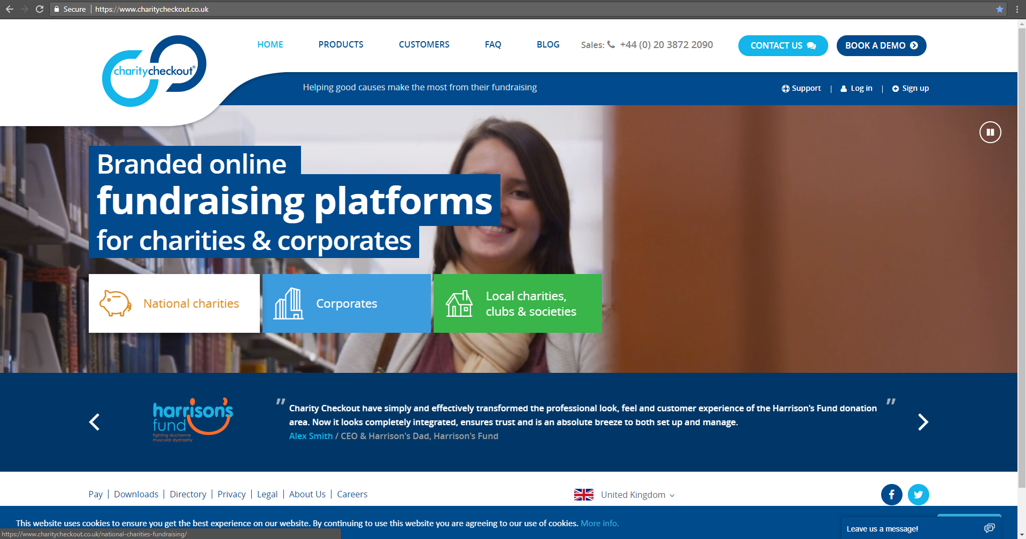
Go to www.charitycheckout.co.uk
You can log into your back office and access all your fundraising page and donation information

Slide 3
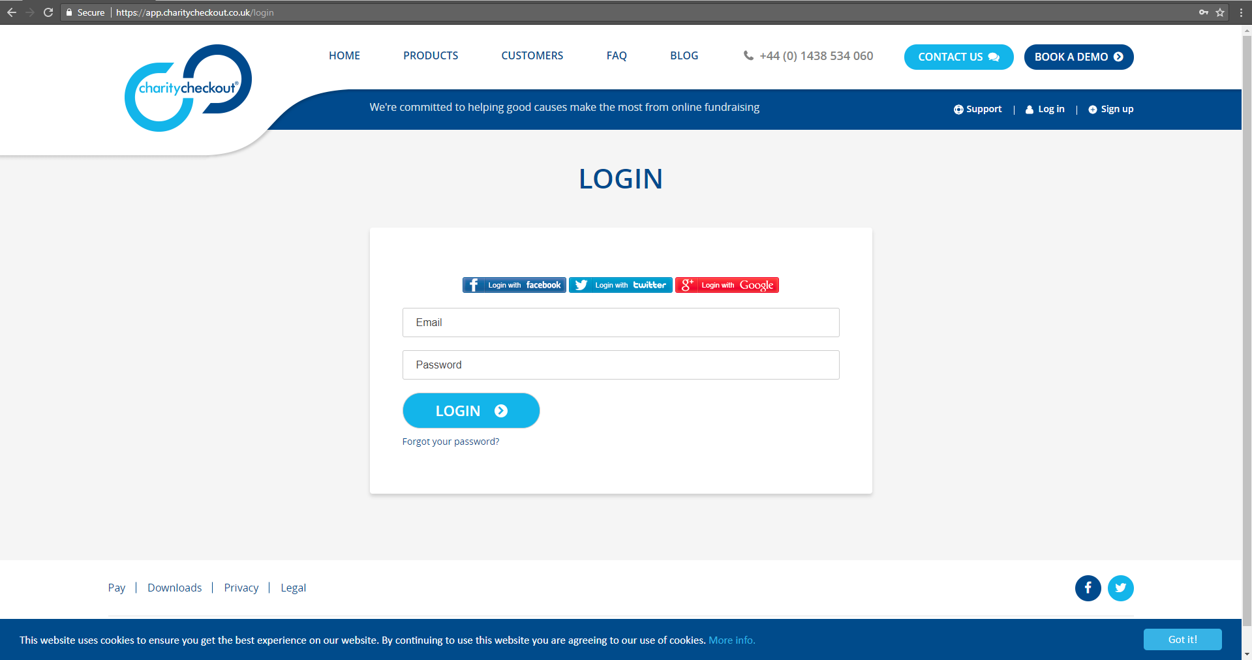
If you used facebook, twitter or google to log in when you created your fundraising page, do use the same again.
If you can’t remember your password, you can use the ‘Forgot your password?’ click through

Slide 4
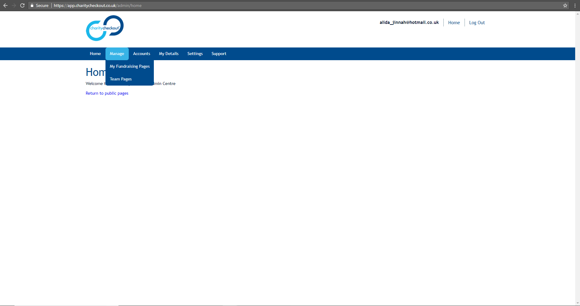
Once in your back office, go to ‘Manage’ and select ‘My Fundraising Pages’

Slide 5
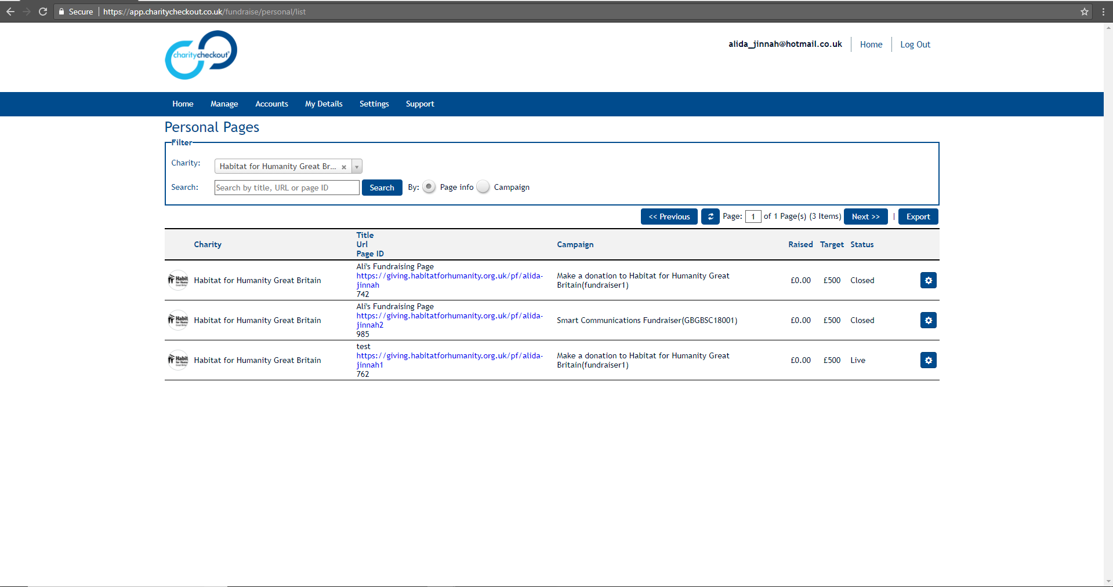
Here you can see all your previous fundraising pages. I am going to use the lower page as my test. As you can see I have raised £0.00 on my page currently.
Click on the cog, to amend your pages or add in offline donations

Slide 6
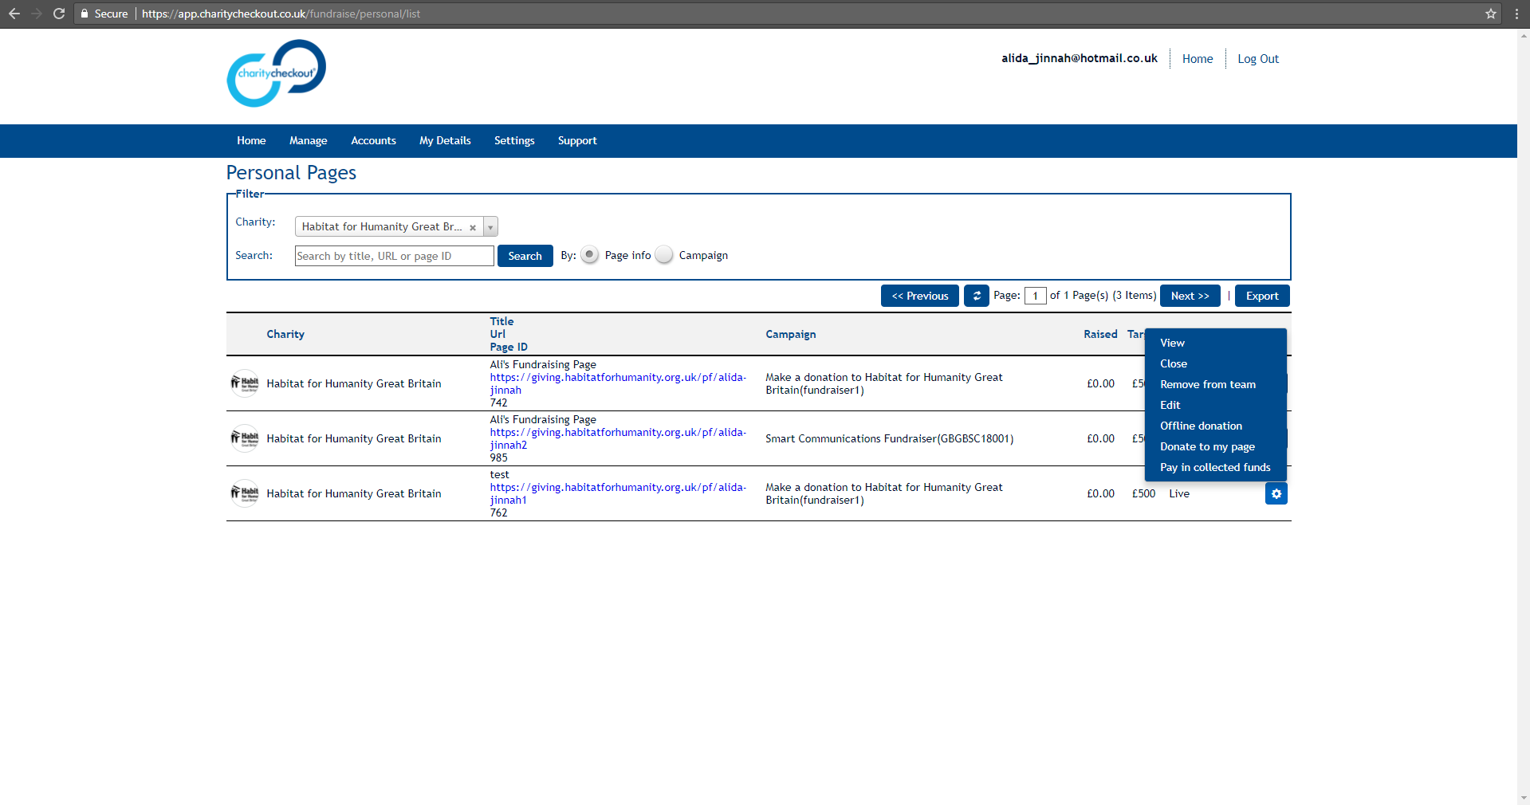
When you click on the cog, you will be asked what you want to do. Click ‘Offline donation’

Slide 7
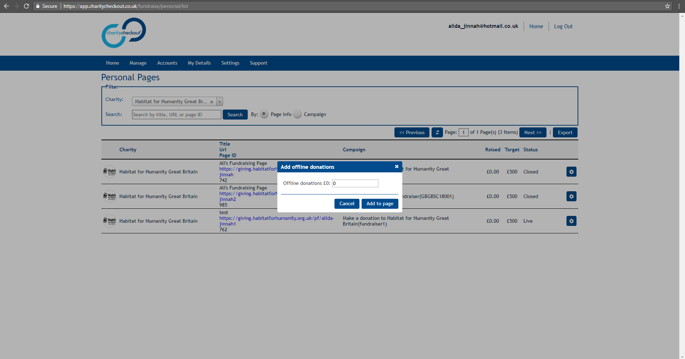
Here you can add in the value of the cash you have collected but want to show on your online page.

Slide 8
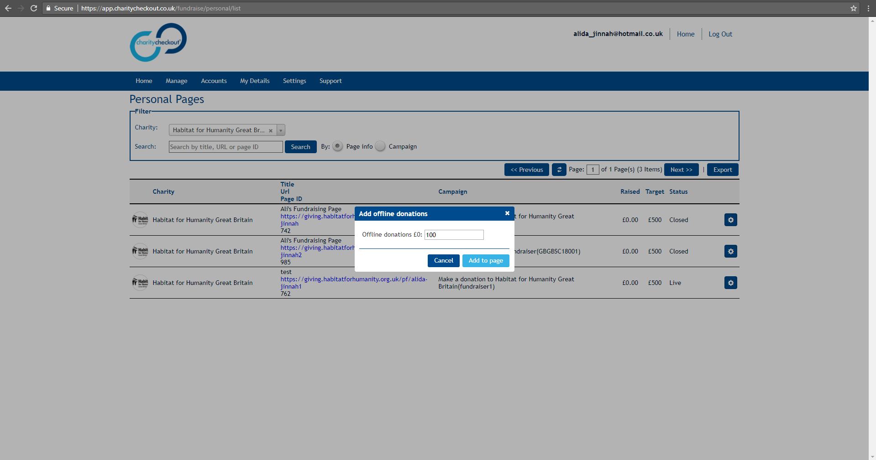
Once the value is added, click ‘Add to page’

Slide 9
You can now see that my value raised has increased, and this will be reflected on my public fundraising page too.

Slide 10
