Slide 2
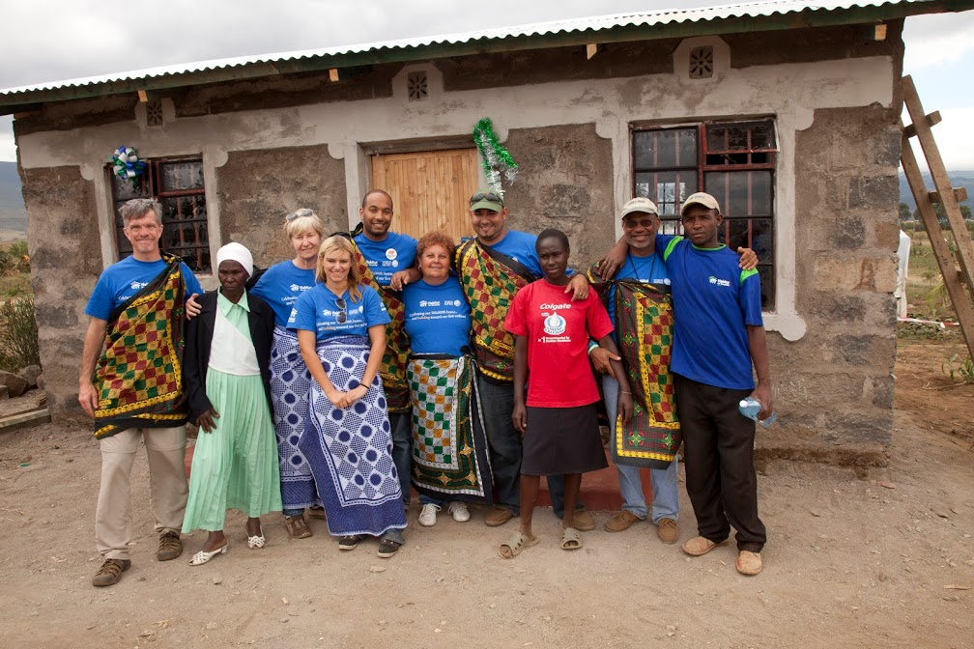
Sustainability and Empowerment
Our role in development
Dignity
Self-reliance
Telling Our Story

Slide 3
Habitat for Humanity GB
Our Vision
Our vision is a world where everyone has a safe and decent place to live, and a world where housing poverty and homelessness are eliminated. We believe that the home is a key catalyst in helping to permanently break the cycle of poverty.
To achieve our vision, we build homes, partnerships, communities and networks; since 1976, we have built more than 1 million homes and served over 10 million people.

Slide 4
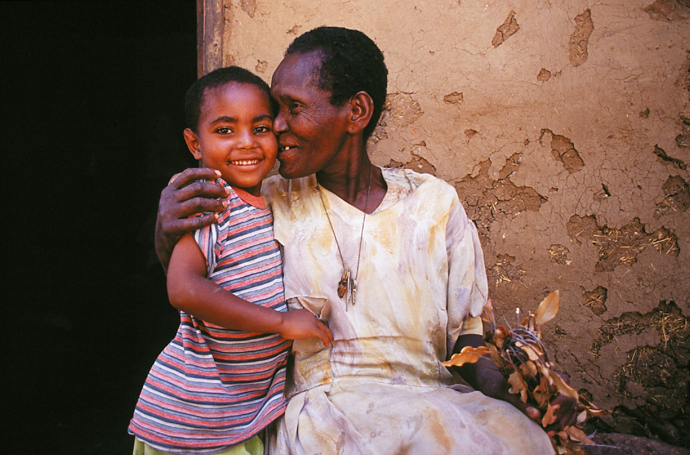
Our role in development
Notes:
1 - Safe, decent housing improves health Clean and warm housing is an essential input for the prevention and care of people affected by diseases of poverty such as HIV/ AIDS, tuberculosis, diarrhoea, and malaria. In Malawi, children under five years who live in Habitat for Humanity houses had 44% less malaria, respiratory, or gastrointestinal diseases compared to children living in traditional houses.
2 - Home is a great means for creating wealth. Home ownership is an important means of wealth accumulation for families, especially those with a lower income. In low-income countries, housing construction creates job opportunities for migrants to cities and stimulates the creation of small business. The process of securing land tenure for informal settlements helps to increase access to credit.
3 - Good housing in communities attracts economic investment and development Good housing also contributes to thriving school systems and community organisations. It is a catalyst for civic activism and a stimulus for community-based organisations. Safe homes and neighbourhoods, in which residents are satisfied with housing conditions and public services, help to build social stability and security

Slide 6
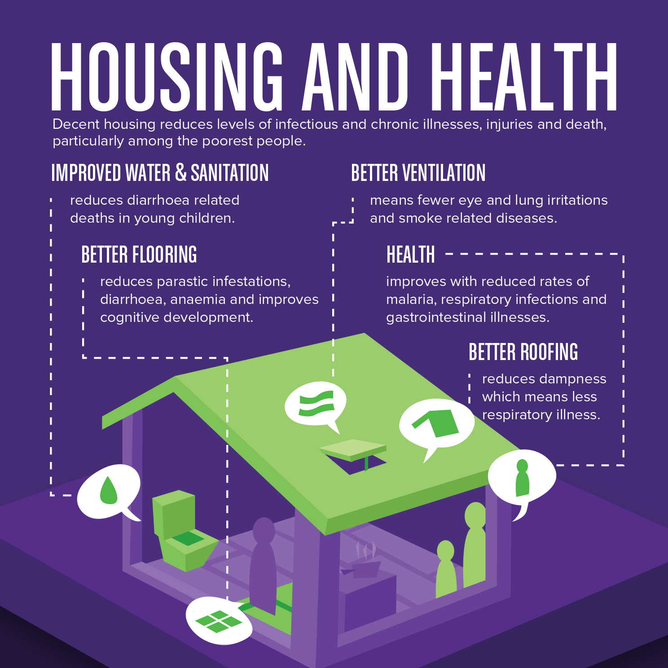

Slide 8
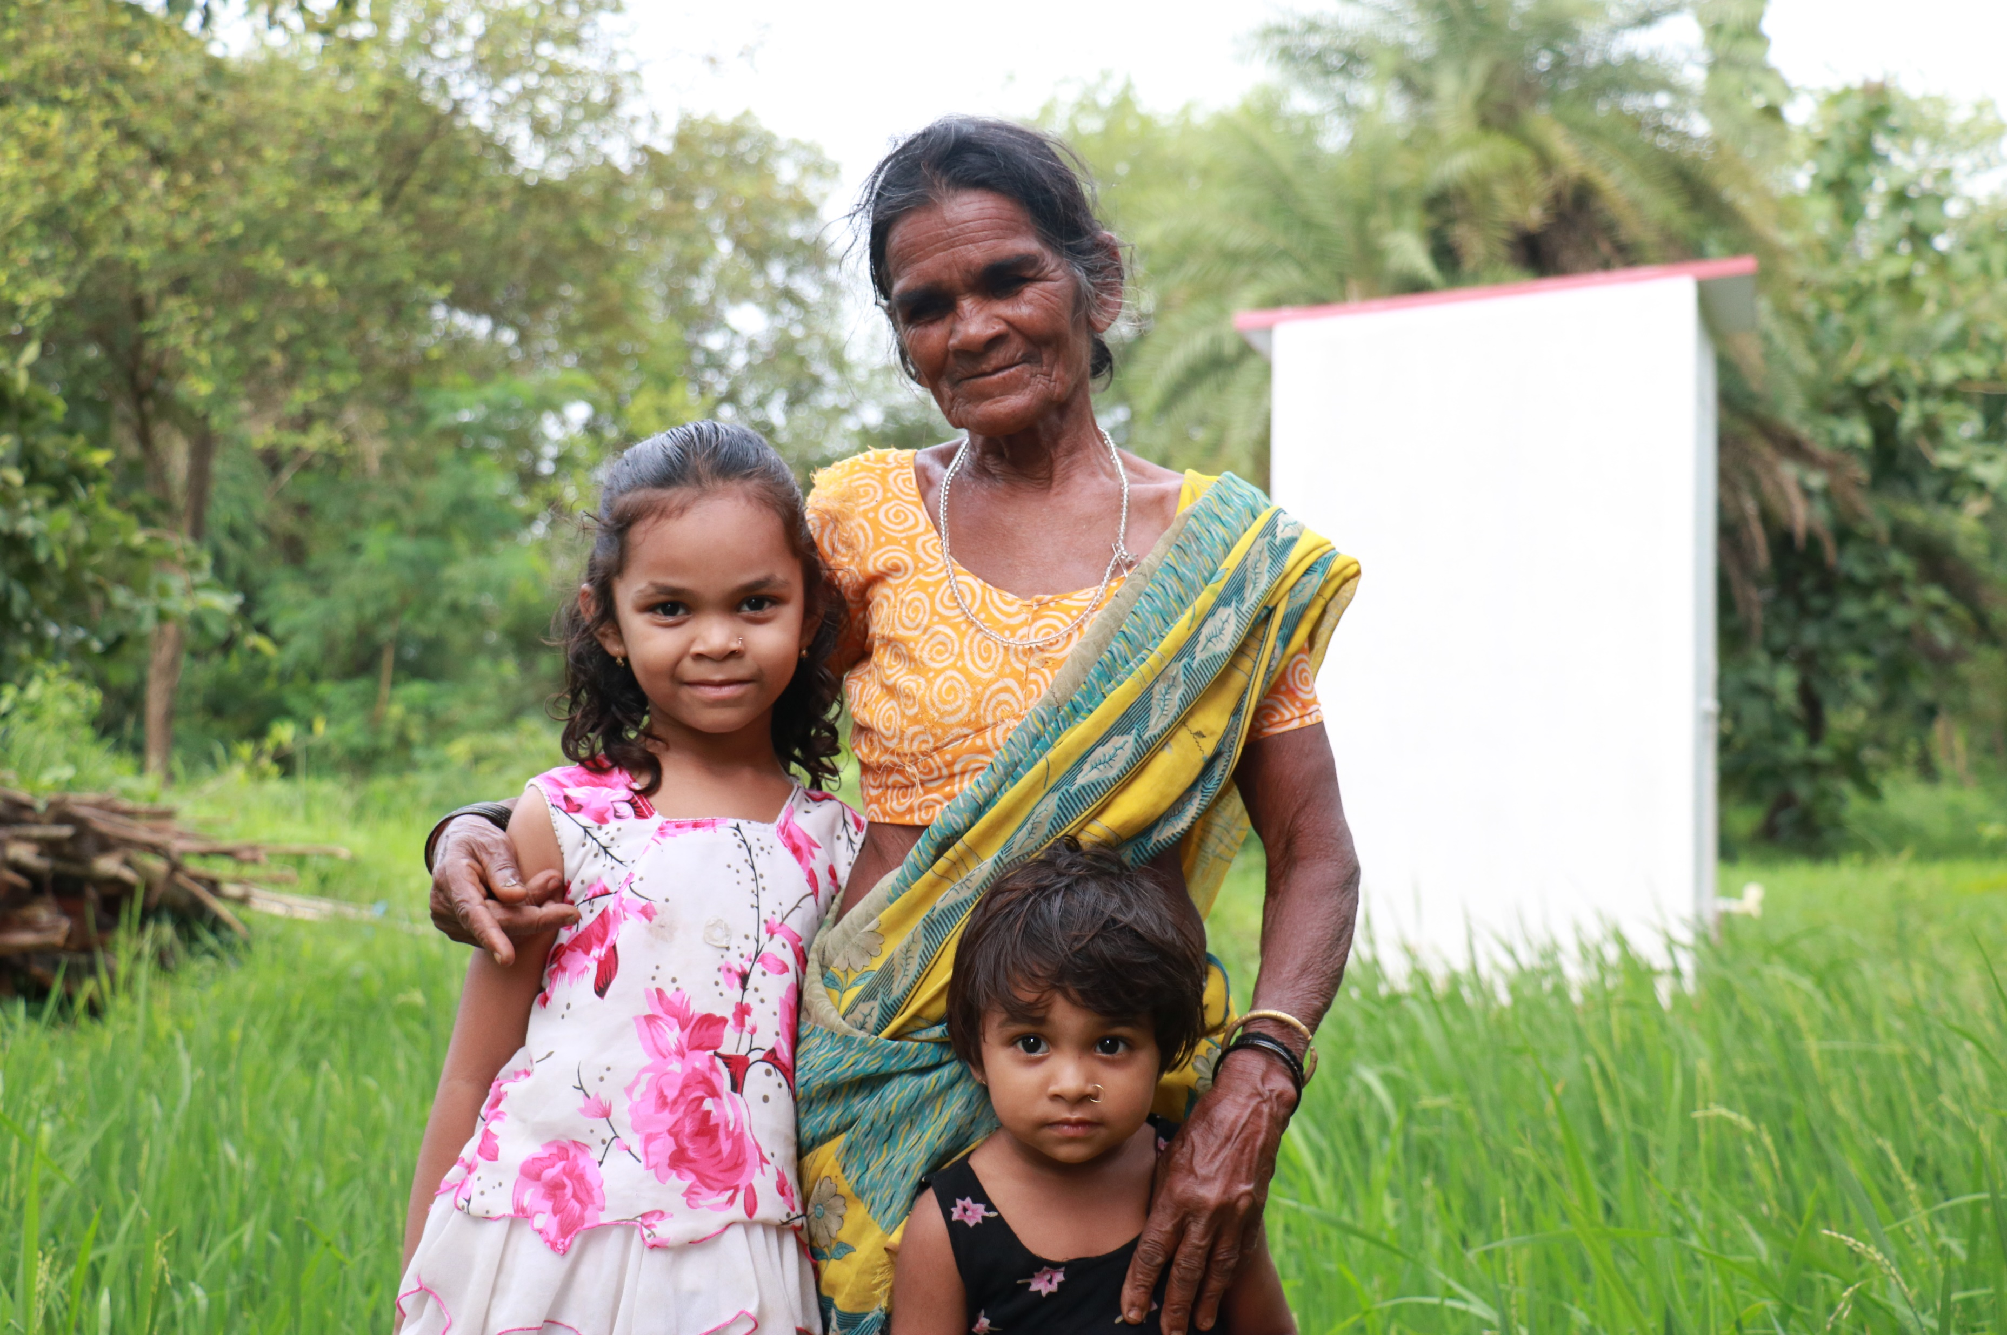

Slide 9
Notes:
MC

Slide 10
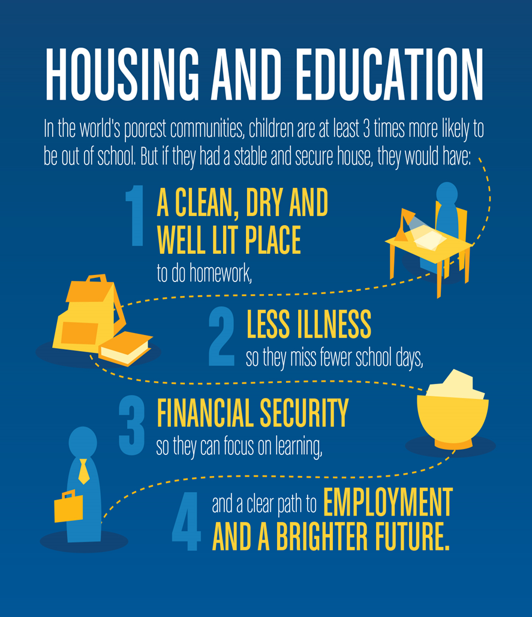

Slide 11
Notes:
MC

Slide 12
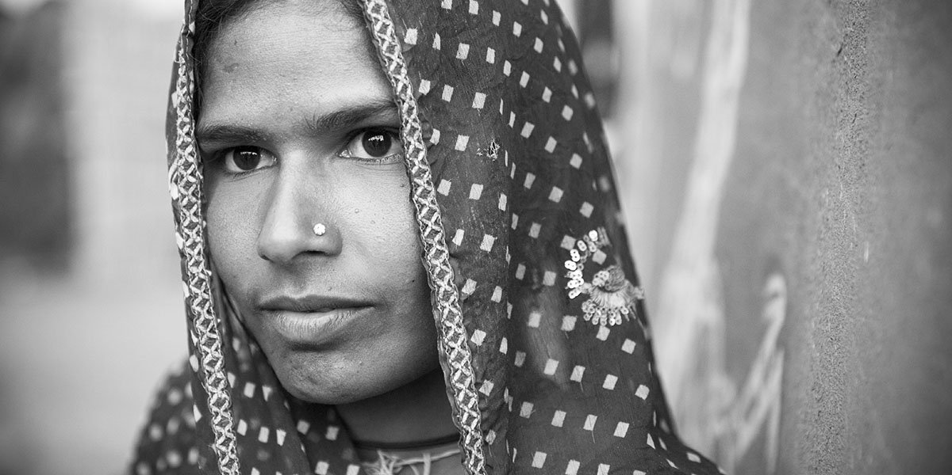
Our role in development
Notes:
NM
Development context
International development charity. Not adventure travel.
Ethical volunteering. We are guided ethics in development.
Photos
How will the photos impact on the safety, well-being and rights of the person being photographed.
- appropriately clothed
- Reflect spirit of mission
Photographing children – written or verbal permission from a parent or guardian. If in doubt, how would I want a child I know to be treated.
Respect for HFH staff and community
Reasonable requests
Teaching moments
Visa application queues
India visas – inconvenience

