Slide 2
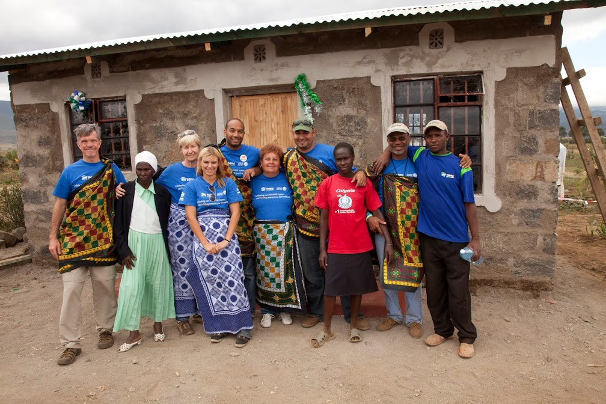
Sustainability and Empowerment
Our role in development
Dignity
Self-reliance
Telling Our Story

Slide 3
Our role in development

Slide 4
Habitat for Humanity GB
Our Vision
Our vision is a world where everyone has a safe and decent place to live, and a world where housing poverty and homelessness are eliminated. We believe that the home is a key catalyst in helping to permanently break the cycle of poverty.
Our role in development

Slide 5
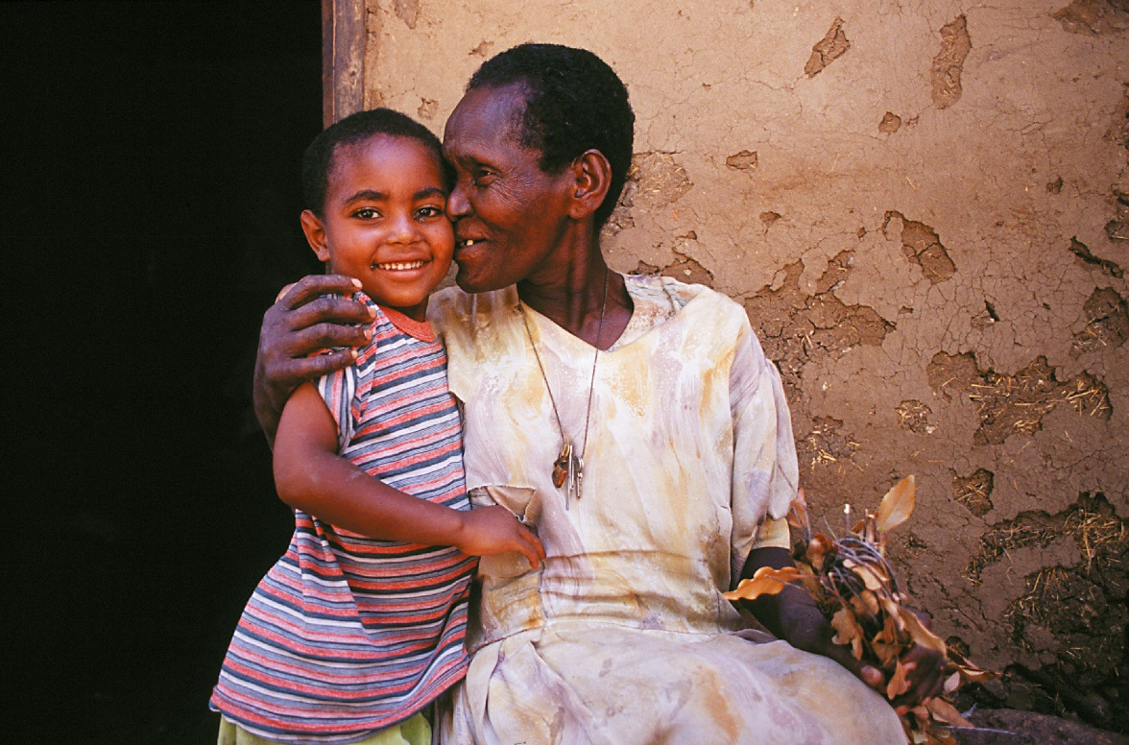
Our role in development
Notes:
1 - Safe, decent housing improves health Clean and warm housing is an essential input for the prevention and care of people affected by diseases of poverty such as HIV/ AIDS, tuberculosis, diarrhoea, and malaria. In Malawi, children under five years who live in Habitat for Humanity houses had 44% less malaria, respiratory, or gastrointestinal diseases compared to children living in traditional houses.
2 - Home is a great means for creating wealth. Home ownership is an important means of wealth accumulation for families, especially those with a lower income. In low-income countries, housing construction creates job opportunities for migrants to cities and stimulates the creation of small business. The process of securing land tenure for informal settlements helps to increase access to credit.
3 - Good housing in communities attracts economic investment and development Good housing also contributes to thriving school systems and community organisations. It is a catalyst for civic activism and a stimulus for community-based organisations. Safe homes and neighbourhoods, in which residents are satisfied with housing conditions and public services, help to build social stability and security

Slide 6
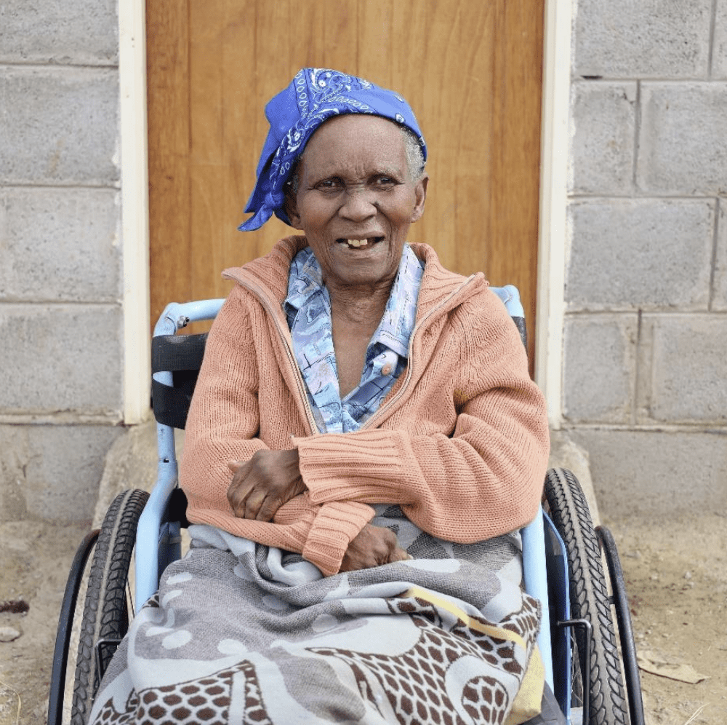
Helping People to Have a Safe Place To Call Home

Slide 7
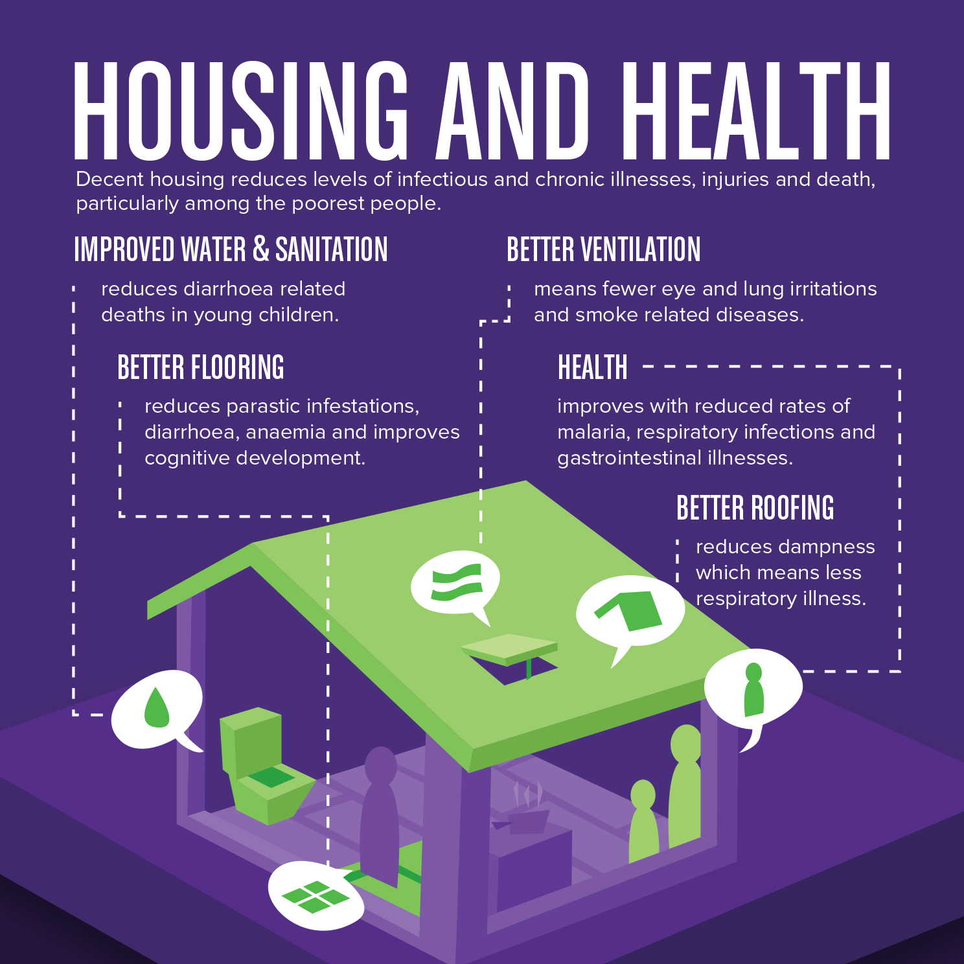
Helping People to Have a Safe Place To Call Home

Slide 8
Helping People to Have a Safe Place To Call Home

Slide 9
Helping People to Have a Safe Place To Call Home
Notes:
MC

Slide 10
Helping People to Have a Safe Place To Call Home

Slide 12
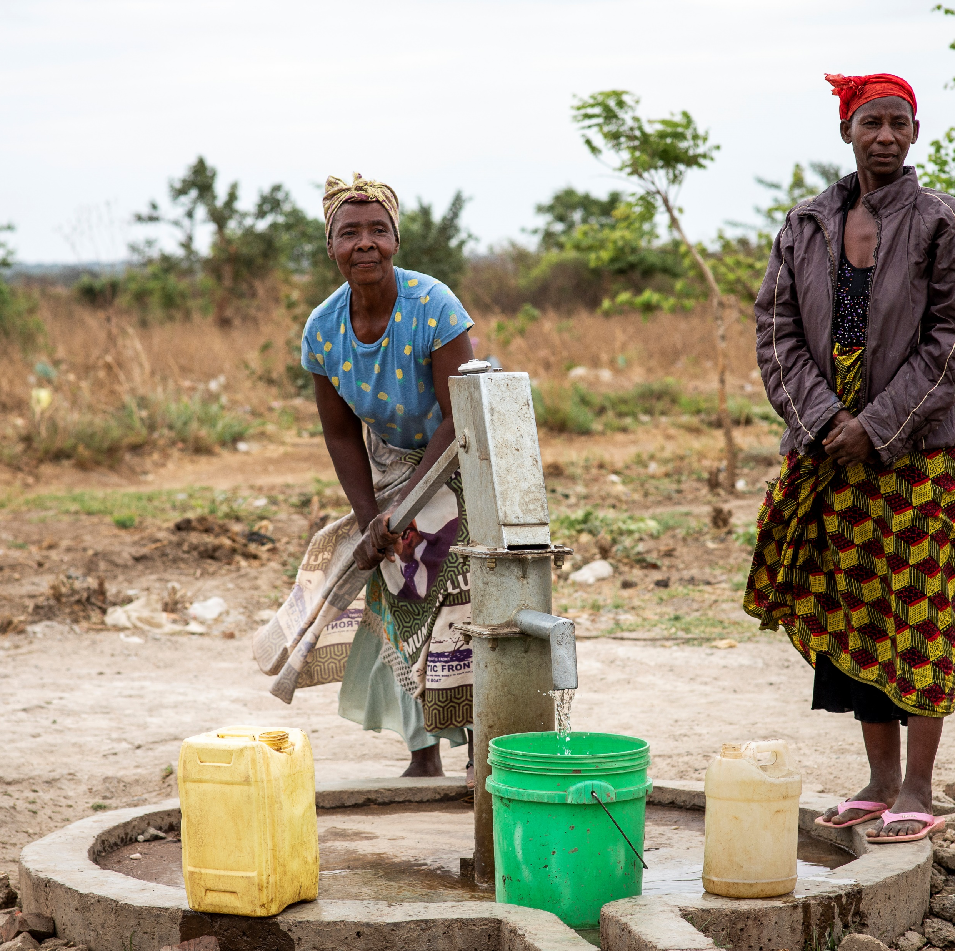
Water Sanitation and Hygiene

Slide 13
Water, Sanitation and Hygiene
Notes:
MC

Slide 14
Water, Sanitation and Hygiene

Slide 15
Our Work in Great Britain

Slide 16
Our work in Great Britain

Slide 17
Our work in Great Britain

Slide 18
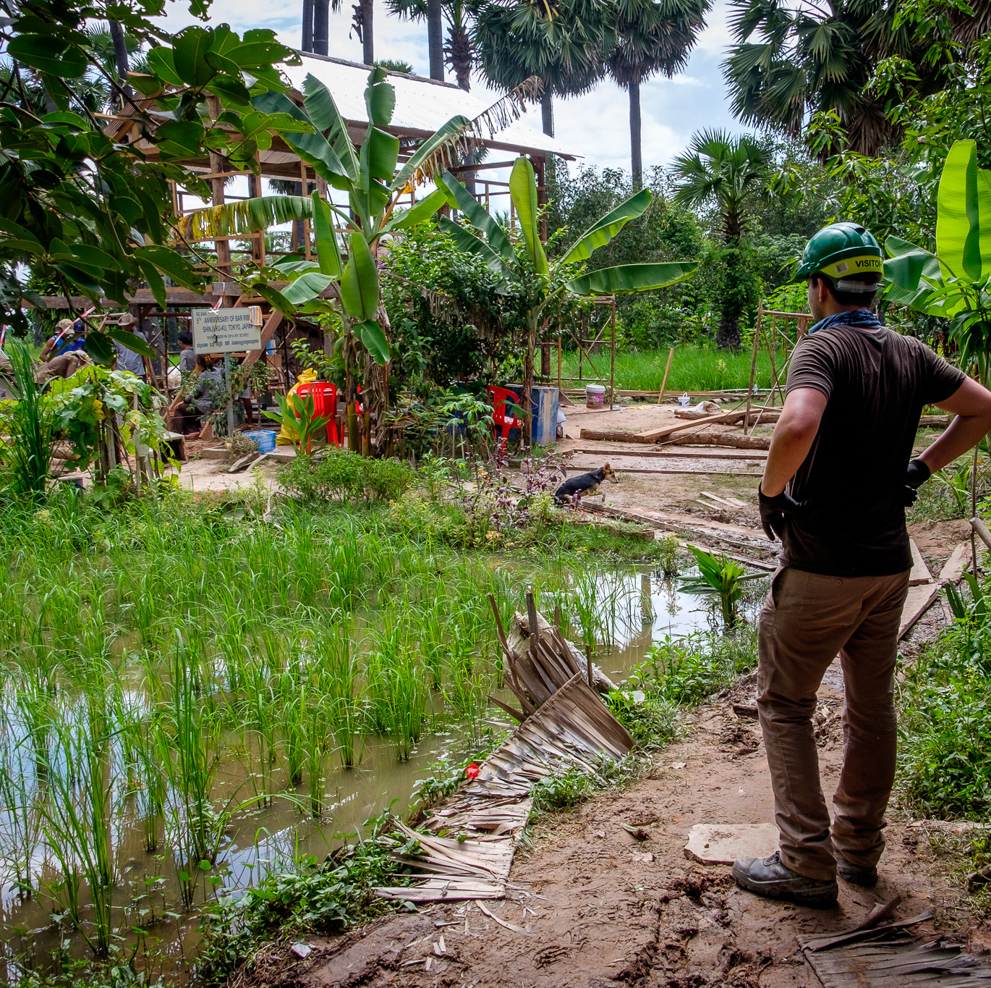
What else do Habitat for Humanity do?

Slide 19
What else do Habitat for Humanity do?

Slide 20
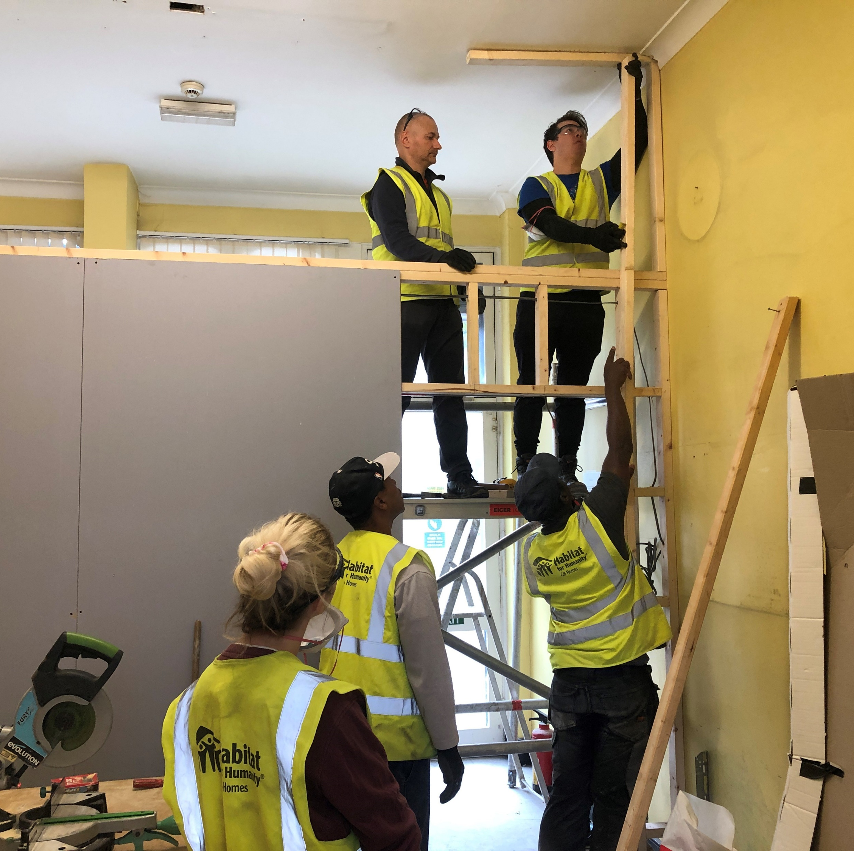
How You Can Get Involved

Slide 21
Fundraise for us!

Slide 22
Partner with Habitat for Humanity

Slide 23
Subscribe to e-news:
www.habitatforhumanity.org.uk/sign-up/
Get Involved: www.habitatforhumanity.org.uk/get-involved/
How You Can Get Involved!

Slide 24
Thank You for Watching

