Slide 1


Habitat for Humanity Great Britain
®
Notes:
Feel free to top and tailor this presentation to fit your needs.

Slide 2

Who we are
Habitat for Humanity is one of the world's leading housing charities.
Since our founding in 1976, together we have helped more than 62 million people globally build their futures on their own terms through access to decent housing in more than 60 countries worldwide.
Notes:
Each year their global projects increase access to housing for millions worldwide through direct construction, advocating for land rights, increasing access to finance for housing, and working to ensure homes and community infrastructure is more resilient to the devastating impact of climate change.

Slide 3
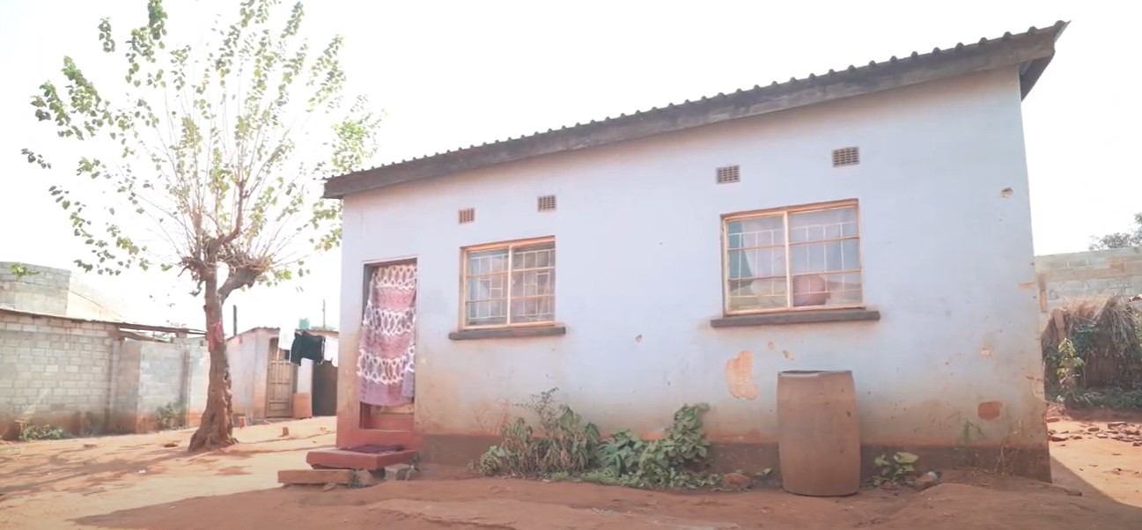
Our vision
Our vision is a world where everyone has a decent place to live
Notes:
Habitat for Humanity has a vision of a world where everyone has a safe place to call home.
The charity's vision in Great Britain is to create more homes for vulnerable people. Whether it's young people leaving the care system, refugees rebuilding their lives, or families struggling with the cost of living everyone deserves a place to call home.

Slide 4
Your project, build or reason for fundraising
  Use this space to add additional information about what you are fundraising for and why you have chosen to fundraise
  Don’t forget to add some photos!

Slide 5
Your ask
  Be clear about what you are asking for. It should be a concrete step that can be answered yes or no, such as a specific monetary amount, sponsorship of a benefit event, etc.

Slide 6

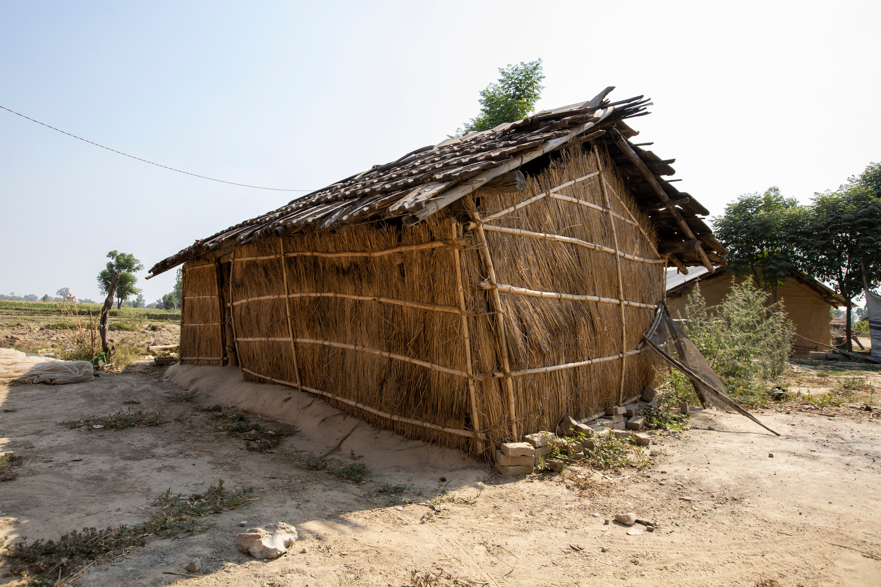
Notes:
*The funds you give will have a direct, tangible impact globally, now and in the long term.
*It can be life-changing for both families and volunteers.
*So, please support our fundraising efforts tonight
Get involved in future opportunities - come and talk to me!
*Spread awareness not just of the problem, but that there are real solutions that all of us can support.
*“Together, we don’t just build houses—we build futures.”

Slide 7
®

